Slide 1
From Punchlines to Patterns: A Quantitative Analysis of Language Use in Stand-Up Comedy
Michael Robinette And Danny Satterthwaite
Notes:
Include our intros
Hi everyone, my name is Danny Satterthwaite. I am doing the csds AMP and got my bs in math from here.
Hi everyone, my name is Michael….

Slide 2

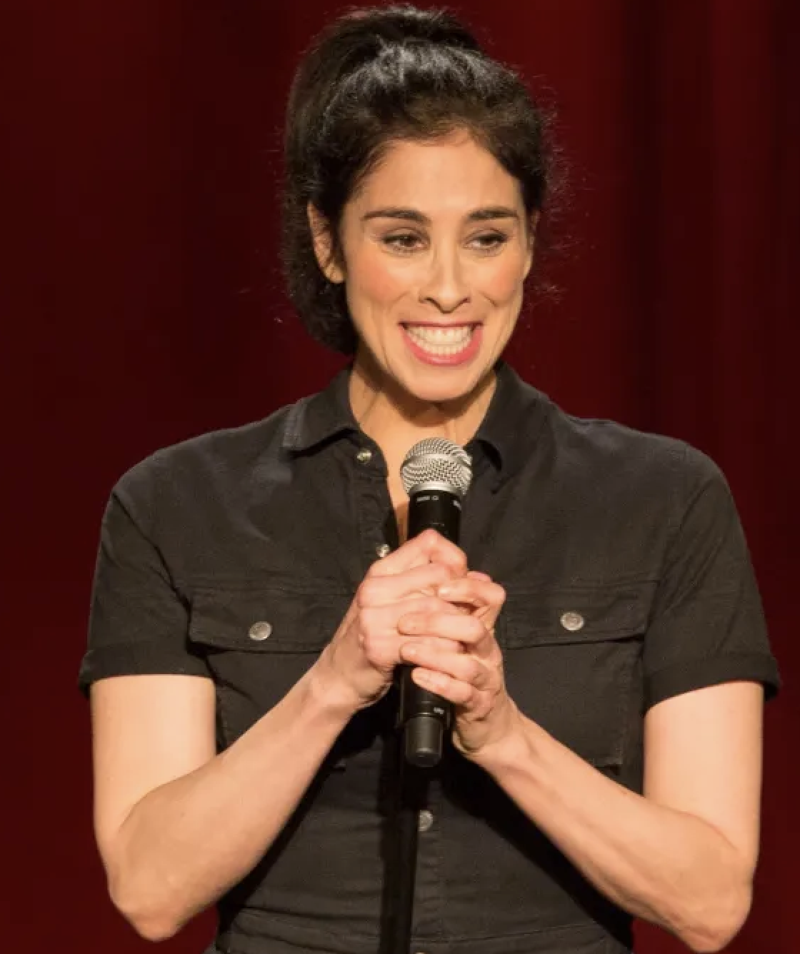
Project Overview
Goal: explore the linguistic and statistical properties within stand-up comedy transcripts
Through the lens of zipf’s and heaps’ laws, we investigate vocabulary distribution and growth patterns in the unique context of stand-up comedy
examine the relationship between innovation rate, transcript length, and performance duration
Being able to improvise is key to stand-up comedy – a relatively untouched area within research
Notes:
Both of us are interested in - and watch a lot of - comedy and have anecdotally noted various trends in what comedians talk about and what words they use
We also want to note that the origin of our innovation rate ideas and analysis is really about improvisation. Being light on ones feet and able to read the audience and pivot if nesccary is a frequent yet crucial and difficult skill for stand up comedians and this, in a quite literal sense got us interested in innovation rates.
And, quite interestingly, in doing more research we found a suprising lack of analytical work on stand up comedy as opposed to more traditional literature so we think we actually have something valuable to contribute to the space
“Although Zipf’s Law has been shown to emerge in various fields, one area that has remained largely unexplored is the stand-up comedy stage. Like other art forms, stand-up comedy explores the depths of human experience, provoking laughter, tears, and even discomfort. However, unlike more traditional forms of art, stand-up comedy specials often blend highly crafted material with spontaneous improvisation, making it a particularly interesting medium through which to examine Zipf’s Law.
“
analyzing each set’s innovation rate, which quantifies the proportion of unique words relative to the total word count,.

Slide 3
About The data
50 comedy specials
Wide ranging and inclusive
Three core features: Title, length of time on stage, and transcript
Data obtained from scraps from the loft website
Notes:
To analyze the comedy specials, we compiled a dataset of over 50 specials. We focused on choosing as wide a range of comedy and being as inclusive as possible.
The main attributes/ variables of interest are length of time on stage, and transcript and lengths of corpus range from 4,329 to 13,771 tokens
Given how much data we have, we explore examples focusing around the midpoint and tails of the data

Slide 4
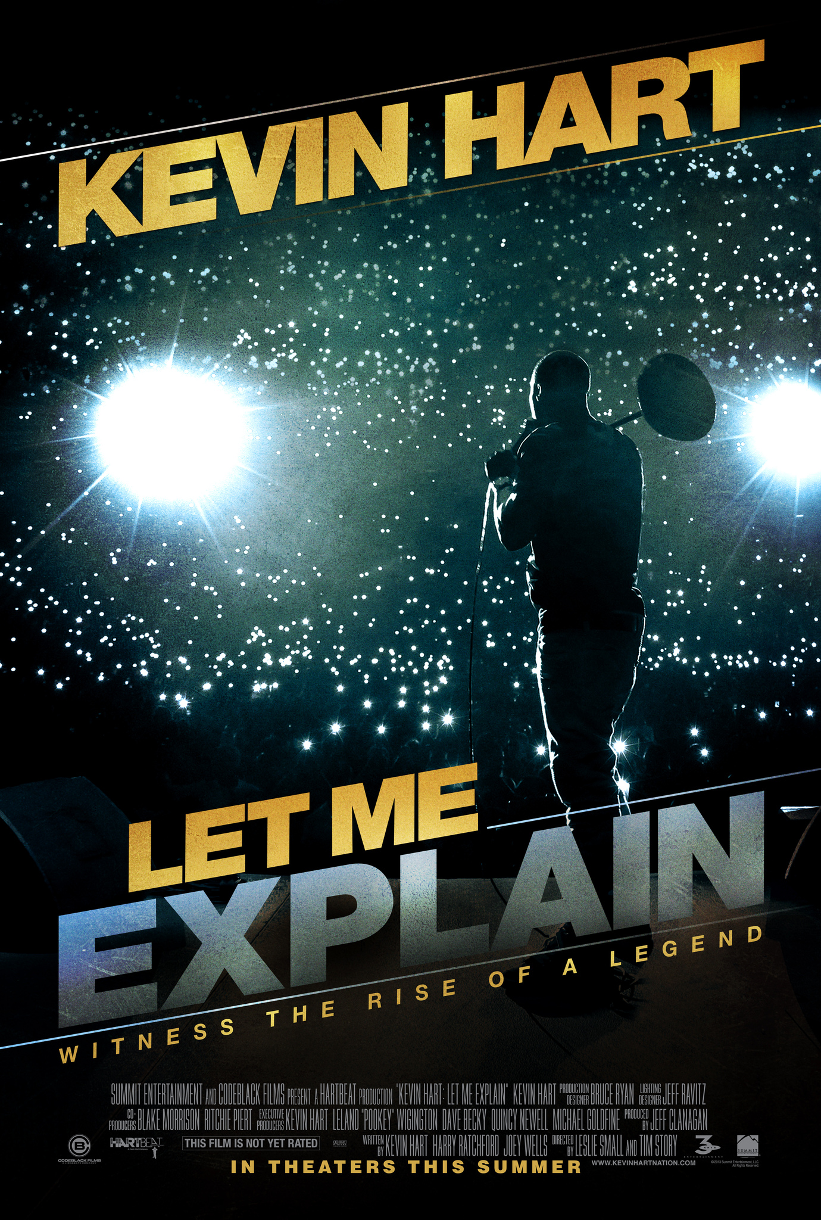
Methodology
Zipf: Common words appear more frequently while for rare words less so
Rich-get-richer mechanism: For the Zipfian behavior words that are used more frequently in the present are more likely to be used in the future.
Heaps: as a set grows longer, the rate of introducing new words decreases
Key parallel with the innovation rate, as Heaps’ Law effectively describes a decaying innovation rate within a single work.
Notes:
As Zipf and Heaps are key to our analysis, we wanted to briefly touch on them before diving into the nitty gritty of our results
Zipf: In other words, the frequency of words that appear a given number of times is inversely proportional to their rank.
On the topic of rich get richer: That is to say, popular words and phrases get repeated
In the context of comedy, this is particularly relevant as comedians often use language that resonates with audiences, leading to repeated usage. Which leads to the idea of innovation rate, ie the introduction of new words and phrases. This all ties to heaps as as Heaps’ Law effectively describes a decaying innovation rate within a single work.

Slide 5
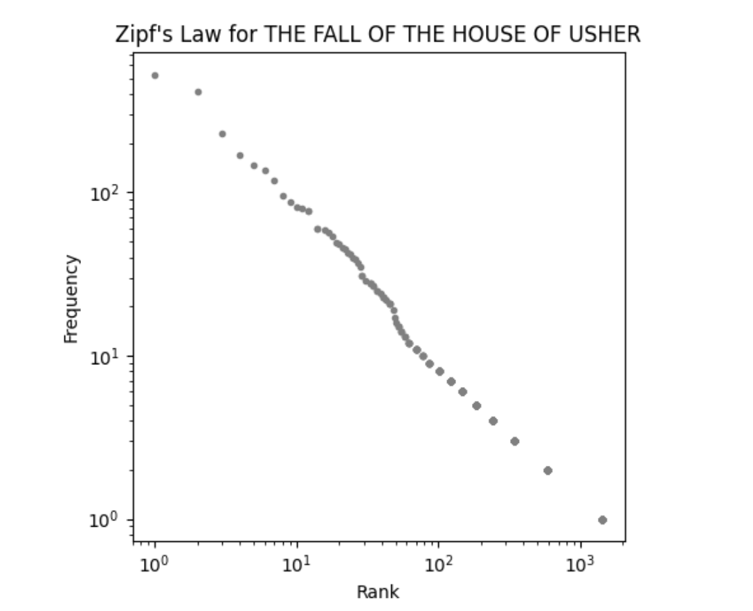
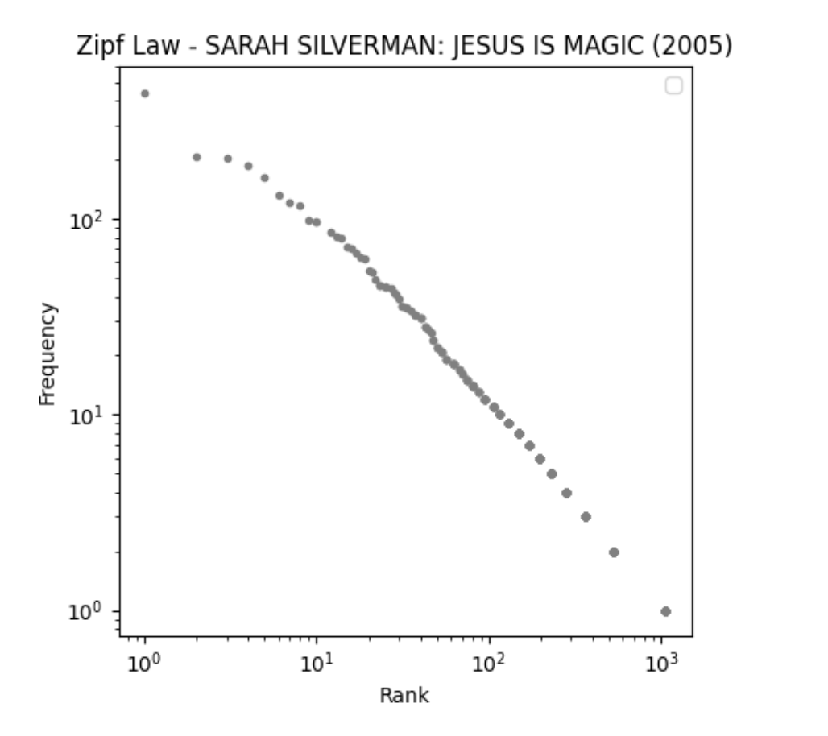
Zipf Results
Notes:
- we wanted to compare sets of various corpus lengths to well known short stories of similar length.
For example, through the lens of zipf of our 50 specials we found that Sara Silverman’s Jesus is Magic has a similar corpus length to Edgar Allan Poe’s The Fall of the House of Usher.
We note that as with over 50 specials meaning there are over 1200 comparisons to do
So, we chose these as they represent the mid range of our data set’s corpus length. We found similar results in the lower and upper ranges as well.
- So, comparing them, WE SEE….. THAT they look very similar and that they obey it BEAF THIS UP

Slide 6
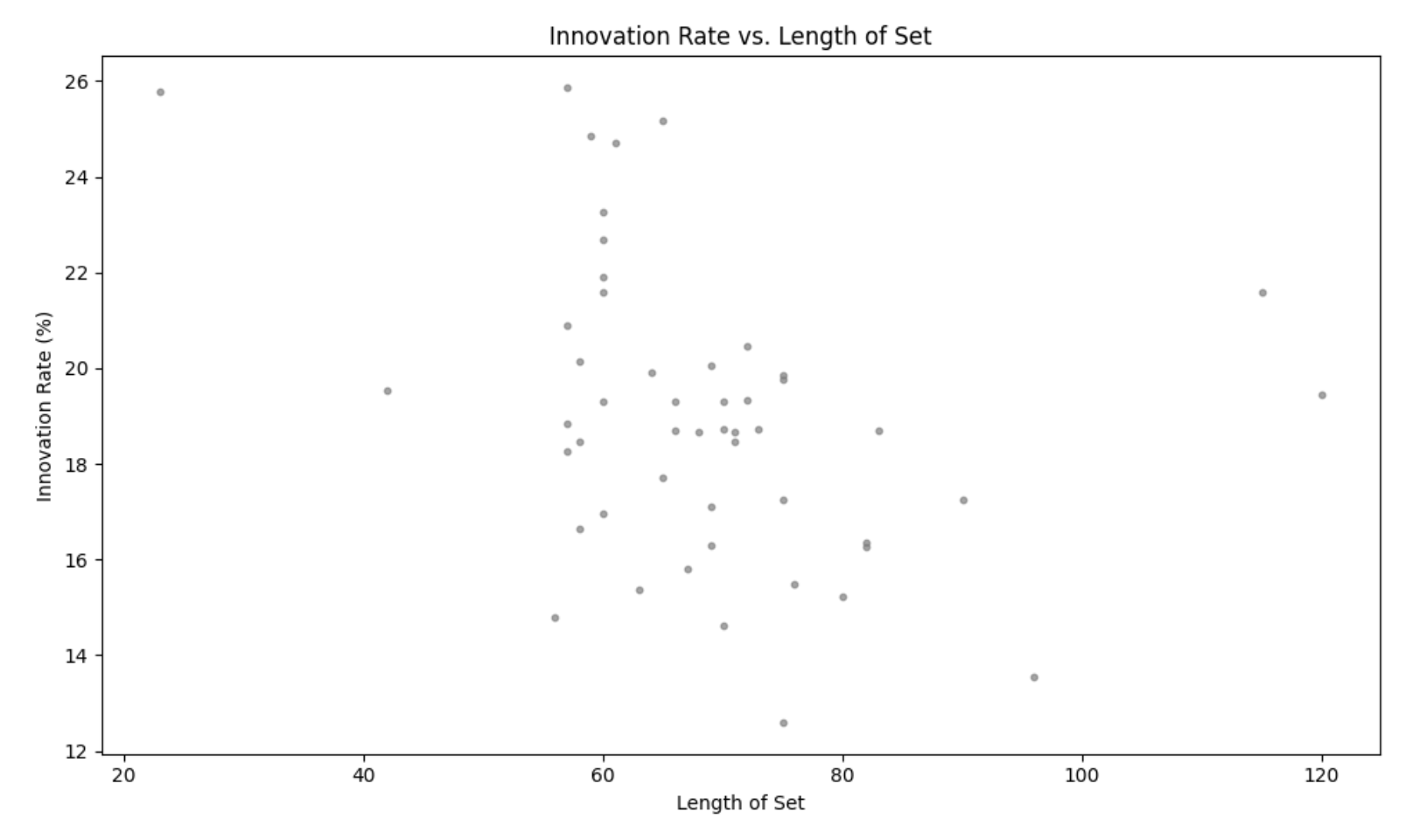
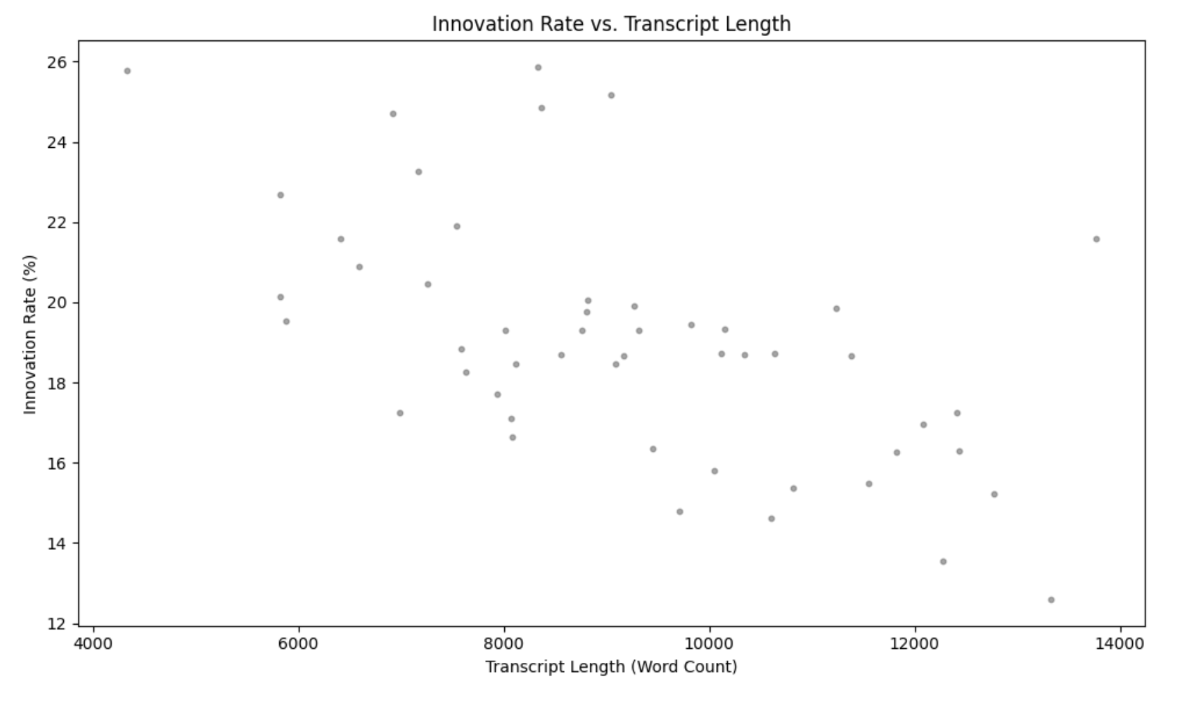
INNOVATION RATE results
Notes:
Next we wanted to examine innovation rate to get a sense of the richness of the vocabulary in the stand-up environment. To calculate innovation rate we capture the number of unique words across a corpus as well as the total number of words and take the ratio.
Again we compare the same texts that represent our mid-range in terms of length - THE FALL OF THE HOUSE OF USHER with an estimated innovation rate of 0.2855 and Jesus is Magic with an estimated innovation rate of 0.2046.
NOTE, OMMITED THE TABLES AS I THINK WE CAN GET QUICKLY TO
THIS ALL LEADS INTO EXPLORING BROAD TRENDS IN INNOVATION RATE
To further investigate we examined how innovation rate differed with respect to the length of time on stage and actual corpus length.
We found that innovation rate seemed to peak and begin to diminish with an increase in time on stage length of corpus. Thus while there is a subtle downward trend for both graphs/ approaches, overall there is no overly dominant clear and obvius bhavior. Really just ever so slightly downward sloping
From the graphs above it would seem that the more time a comedian spends on stage, the longer the corpus, resulting in a lower innovation rate. While this may be true, all comedians in our data set are introducing new vocabulary at a very fast rate where innovation ranges from 12.60 − 25.86.

Slide 7
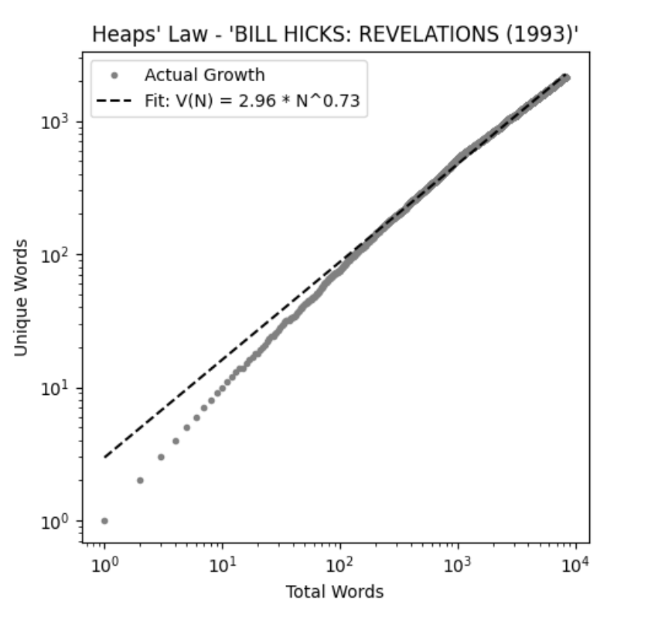
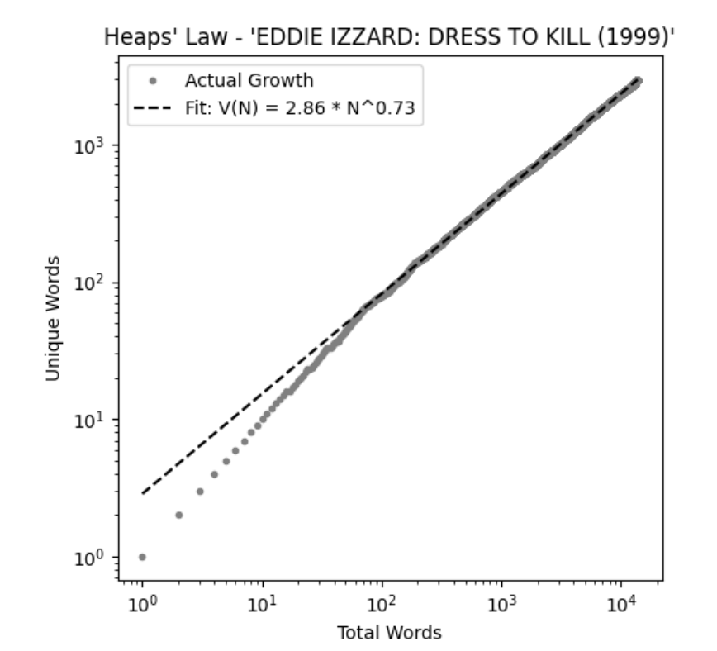
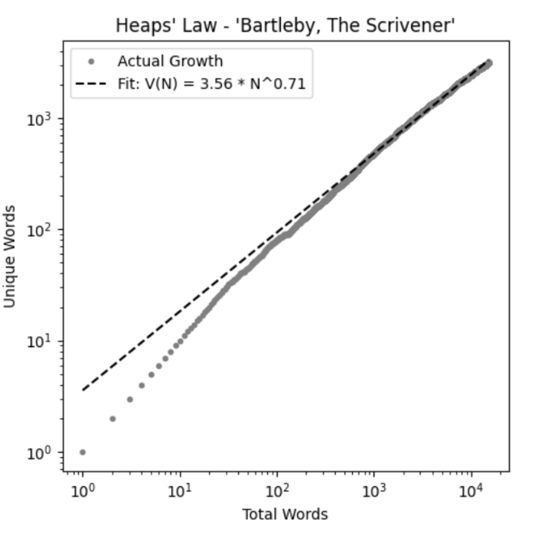
HeapS results
Notes:
Lastly, this all really lent itself to heaps law
So, we examine the details of comedians with highest and lowest innovation rates in the context of Heaps.
We first look at KEVIN HART: LET ME EXPLAIN (2013 which had the lowest innovation rate at 12.60 with a corpus length of 13330. The graphs shows us that Kevin Hart’s vocabulary is still being introduced with a Heaps’ exponent of .61, which suggest a steady introduction of new terms.
On the other side, we BILL HICKS: REVELATIONS (1993) which had the heigst innovation rate of 25.86 with a corpus length of 8330 terms
The really interesting thing here is the exception to the pattern of a diminishing innovation rate in relation to corpus length.
Intesetingly, in the third figure we see Eddie Izzard in Dress to Kill which introduced a total of 13771 words and had the longest corpus in our dataset. However, the innovation rate in this set was 21.57. Izzard also introduced new terms at the same rate as Bill Hicks.
All of this would seem to suggest that comedians introduce new vocabulary at a faster rate that what is considered typical in natural language. This is likely due to the shorter length of the corpus. However, stand-up comedy differs from many other linguistic systems normally analyzed through the lens of Zipf in that there is often steady topic transition as well as improvisation.

Slide 8
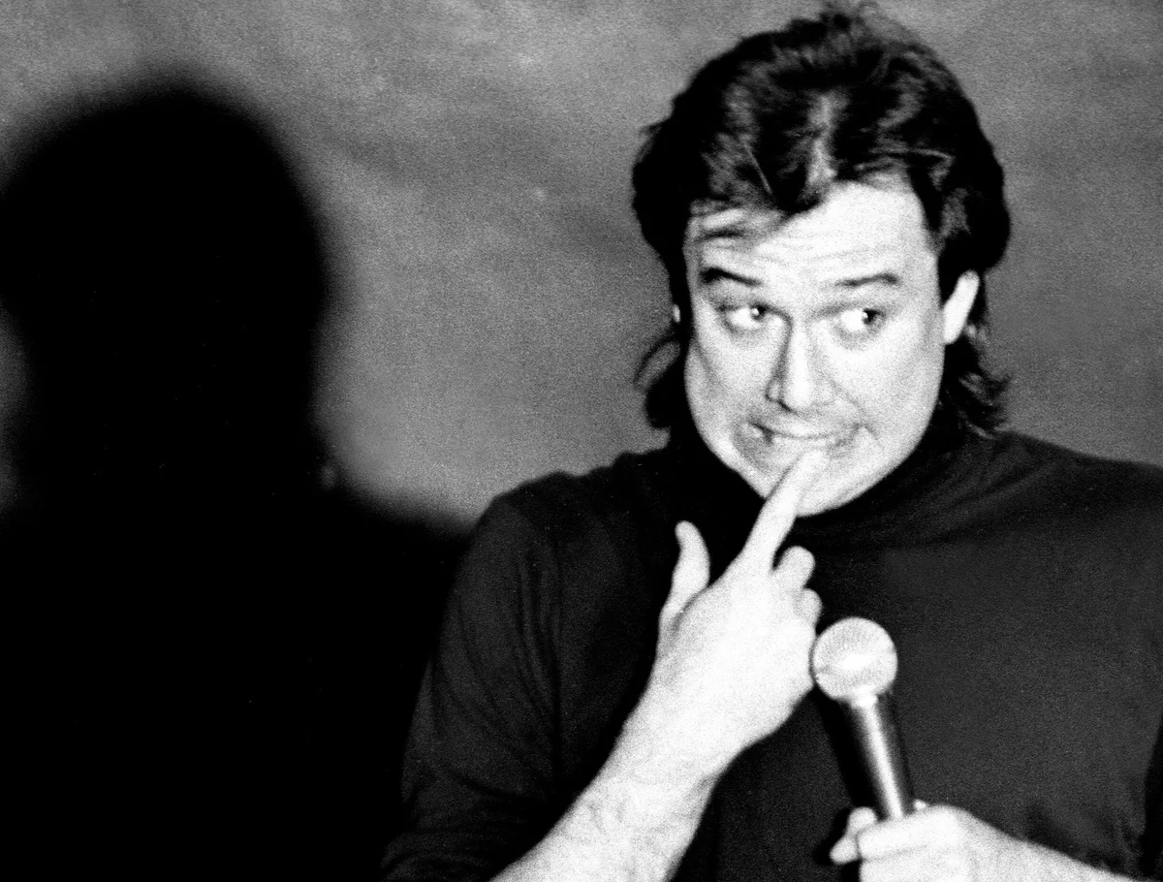
Conclusion and Next Steps
Scaling of language in stand-up comedy mirrors patterns seen in other forms of narrative, such as those found in short stories
We built this dataset and while not complete (more is better), it is certainly a solid starting point for further analysis both by ourselves and others
Provide evidence and rational for specials selected
Compare to other mediums
Notes:
We could also really focus on just heaps or just innovation rate and go deeper on one.
- Key here is really that a big piece of the works was collecting the data. Its not fun but we have made a good start and while of cource more is always better, we think it’s a really good jumping off point for others in the field.
We also recognize that this our first paper of this style so in order to really push to get it published we would have to….
Furthermore, (getting at the 3rd and 4th points), if we were to really make a push to make this good enough to publish we would want to beef up our justications for the comedies selected to make sure it was both statistically and wholesticlly as robust as possible. We could do this by including IMDB ratings, Netflix ratings, or other relevant metrics. Also, while we compared our specials to literature as we already had tools in place to analyze texts from Project Gutenberg, other formats like speaches or podcasts could be more relavant comparsion. These formats have been subject to prior analysis and might yield insights into how stand-up comedy relates to other spoken-word media.

